Slide 1
MGS 723: Geodynamics
Class 8: Viscous deformation I
Main reference for today: Becker and Faccenna, Tectonic Geodynamics

Slide 2
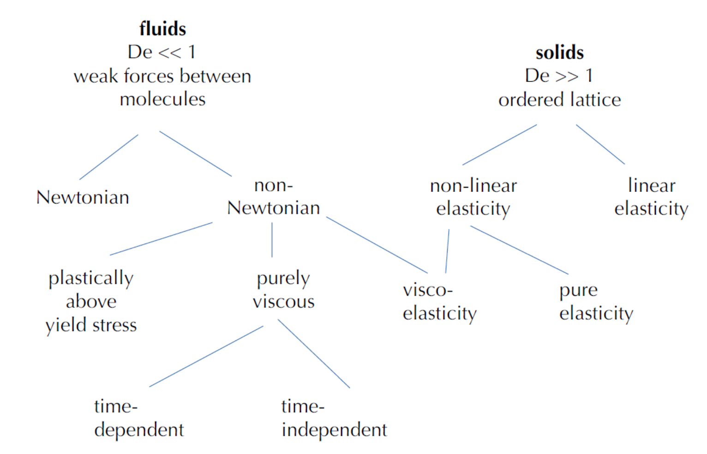
Rheology
Becker and Faccenna

Slide 3
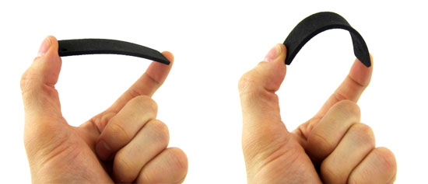
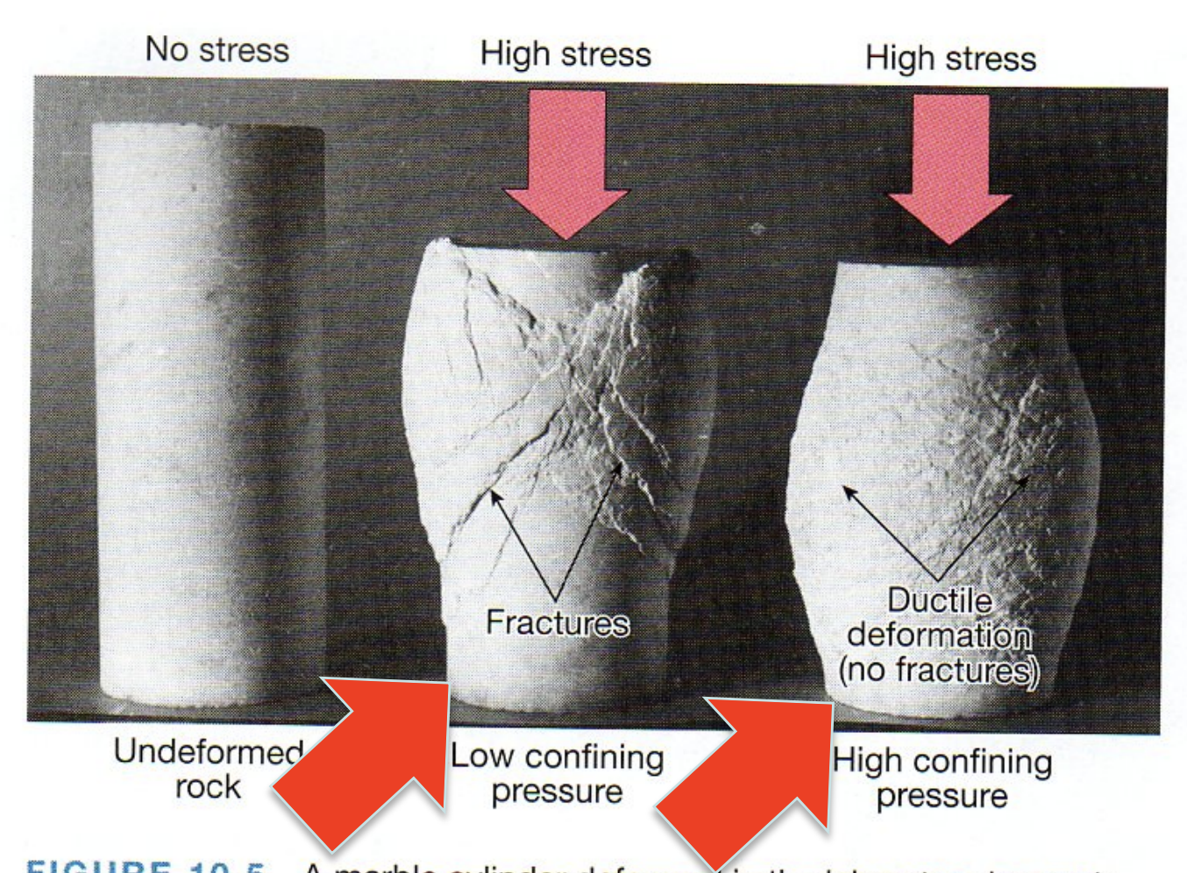
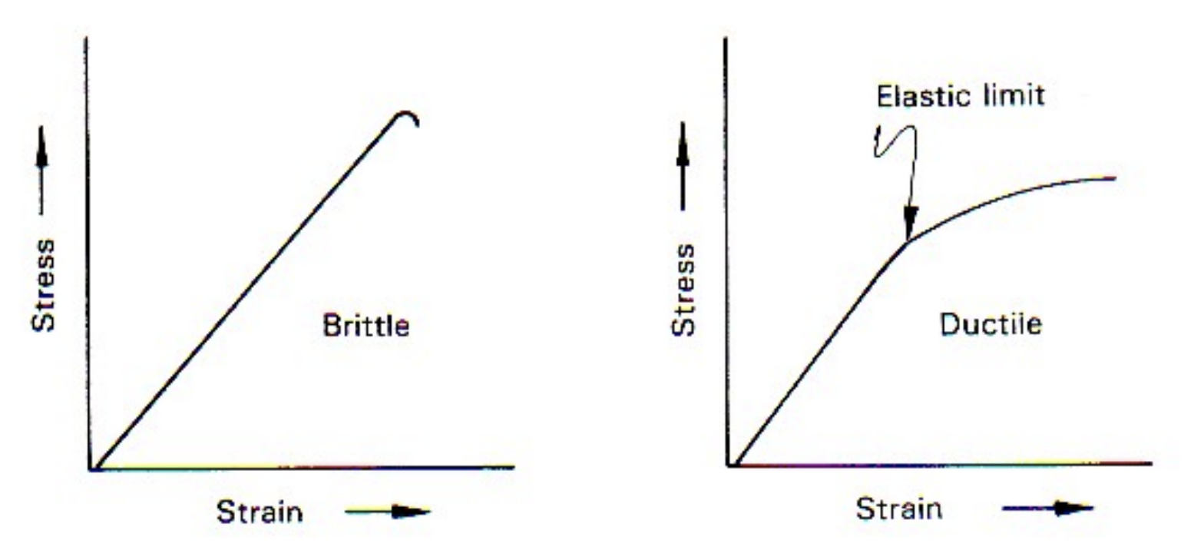
Rheology
So far:
Brittle failure/plastic yielding at $σ≥ σ_{y}$
Elasticity: $σ∝ ε$
elasto-brittle
elasto-plastic
Notes:
https://www3.nd.edu/~cneal/PlanetEarth/Chapt-11a-Rock-Mechanics.pdf

Slide 4
What about fluids?
Viscous flow
Becker and Faccenna

Slide 5
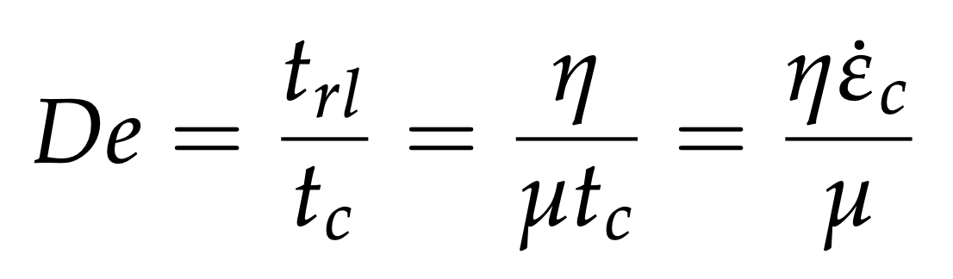
Deborah number
An example of a non-dimensional number that describes the behavior of the system.
In this case, it is a ratio of time scales that can be used to distinguish whether a material deforms as an elastic solid or viscous fluid:
Relaxation time
Characteristic time, or time of observation/forcing

Slide 6
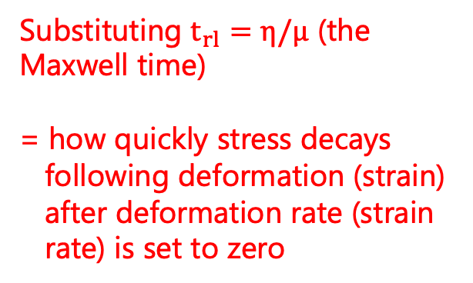
Deborah number
An example of a non-dimensional number that describes the behavior of the system.
In this case, it is a ratio of time scales that can be used to distinguish whether a material deforms as an elastic solid or viscous fluid:
Substituting $t_{rl}=η/μ$ (the Maxwell time)
= how quickly stress decays
following deformation (strain)
after deformation rate (strain
rate) is set to zero

Slide 7
Deborah number
An example of a non-dimensional number that describes the behavior of the system.
In this case, it is a ratio of time scales that can be used to distinguish whether a material deforms as an elastic solid or viscous fluid:
Substituting $t_{rl}=η/μ$ (the Maxwell time)
= how quickly stress decays
following deformation (strain)
after deformation rate (strain
rate) is set to zero
Or: For deformation times larger than the Maxwell time, the material deforms mainly in a viscous way

Slide 8
Deborah number
An example of a non-dimensional number that describes the behavior of the system.
In this case, it is a ratio of time scales that can be used to distinguish whether a material deforms as an elastic solid or viscous fluid:

Slide 9
Deborah number
An example of a non-dimensional number that describes the behavior of the system.
In this case, it is a ratio of time scales that can be used to distinguish whether a material deforms as an elastic solid or viscous fluid:
In the Mantle: De ~ 10²¹.10⁻¹⁵/10¹¹ ~ 10⁻⁵

Slide 10
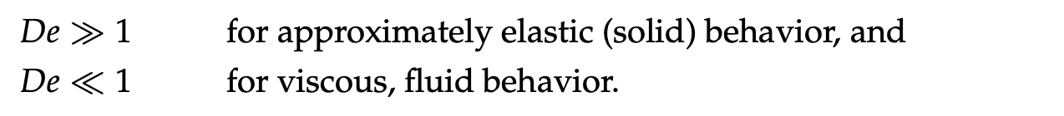
Deborah number
An example of a non-dimensional number that describes the behavior of the system.
In this case, it is a ratio of time scales that can be used to distinguish whether a material deforms as an elastic solid or viscous fluid:
In the Mantle: De ~ 10²¹.10⁻¹⁵/10¹¹ ~ 10⁻⁵

Slide 11
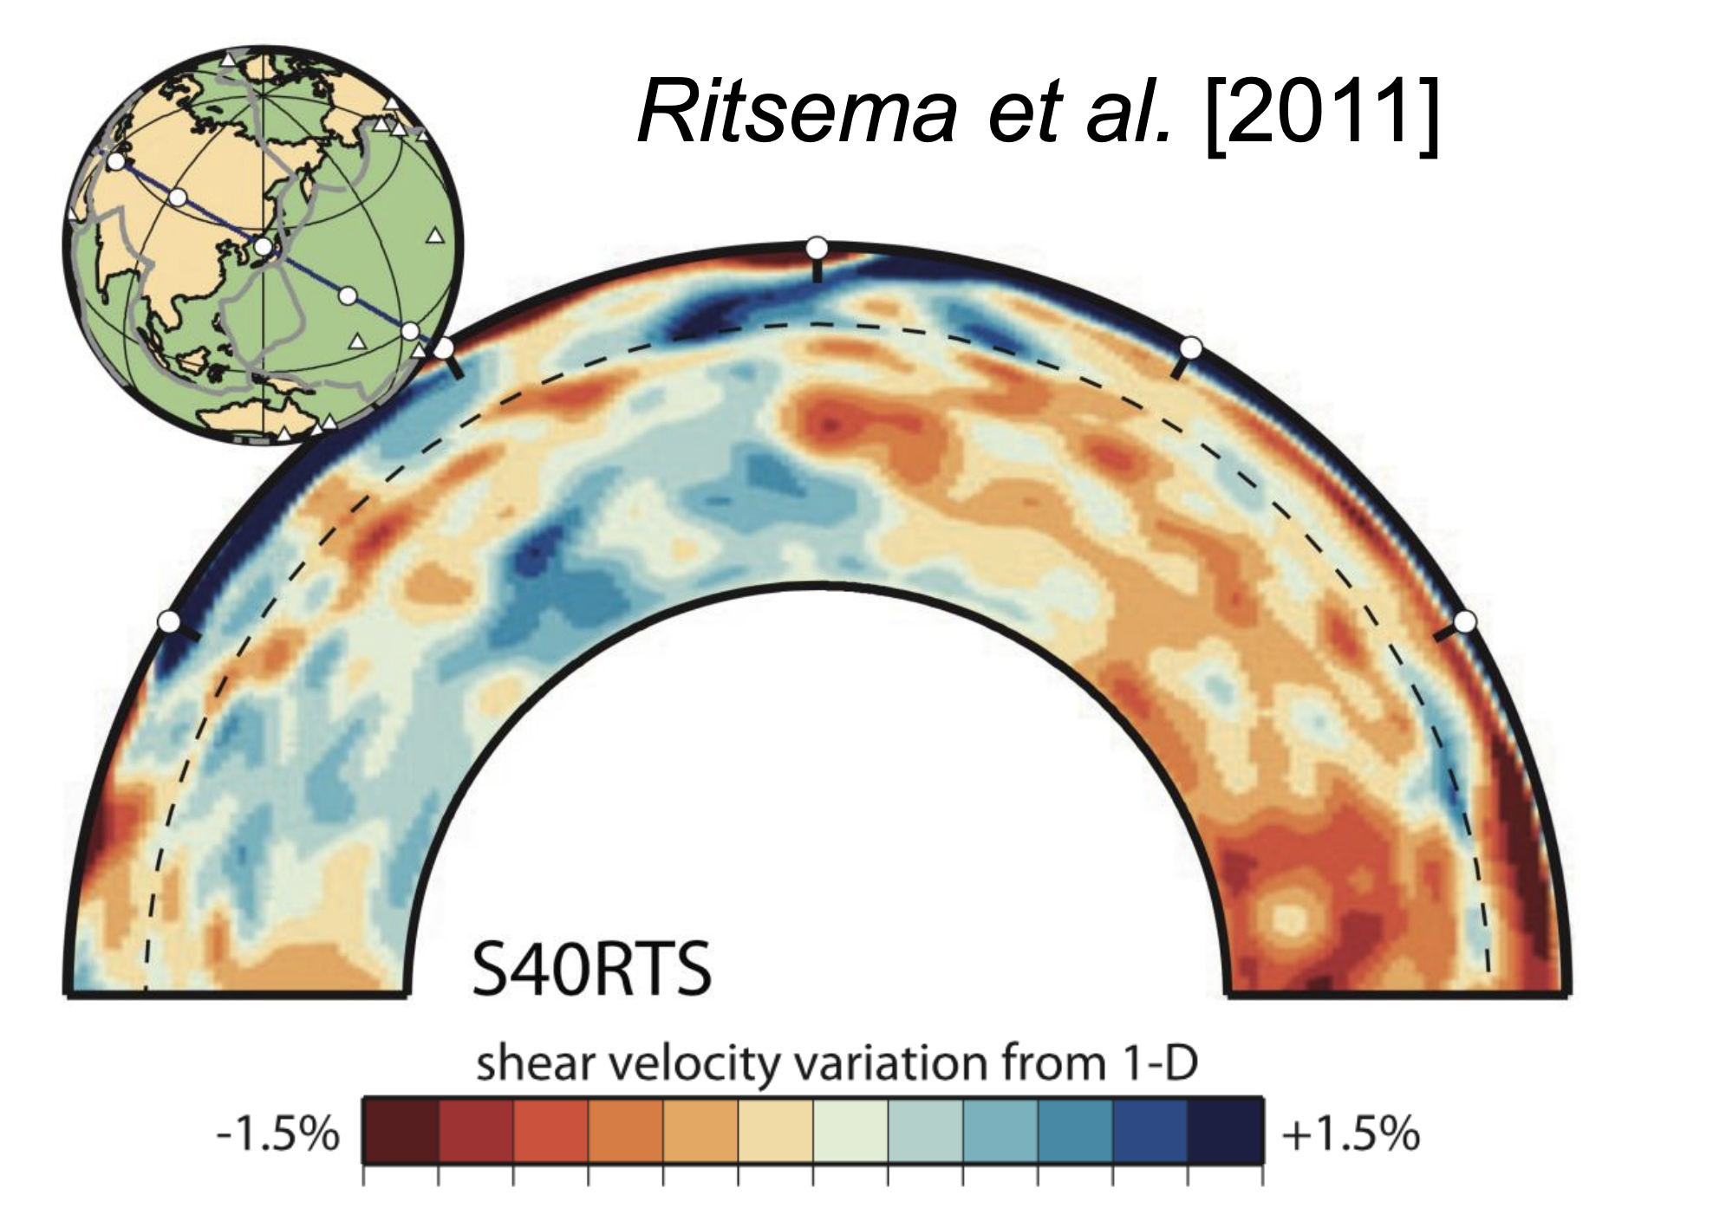
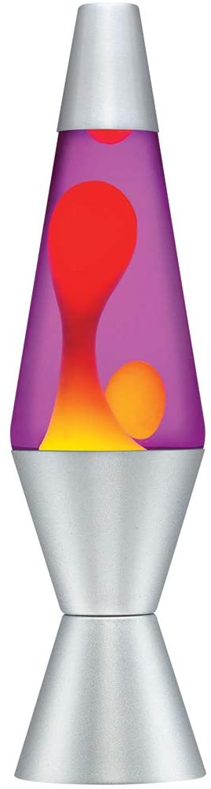
Viscous flow
Mantle convection
Notes:
Temporal evolution of plume generation during third phase by andesite at the bottom boundary layer and dacite at the top boundary layer for simulation #1. The boundary layers become thinner with time.

Slide 12
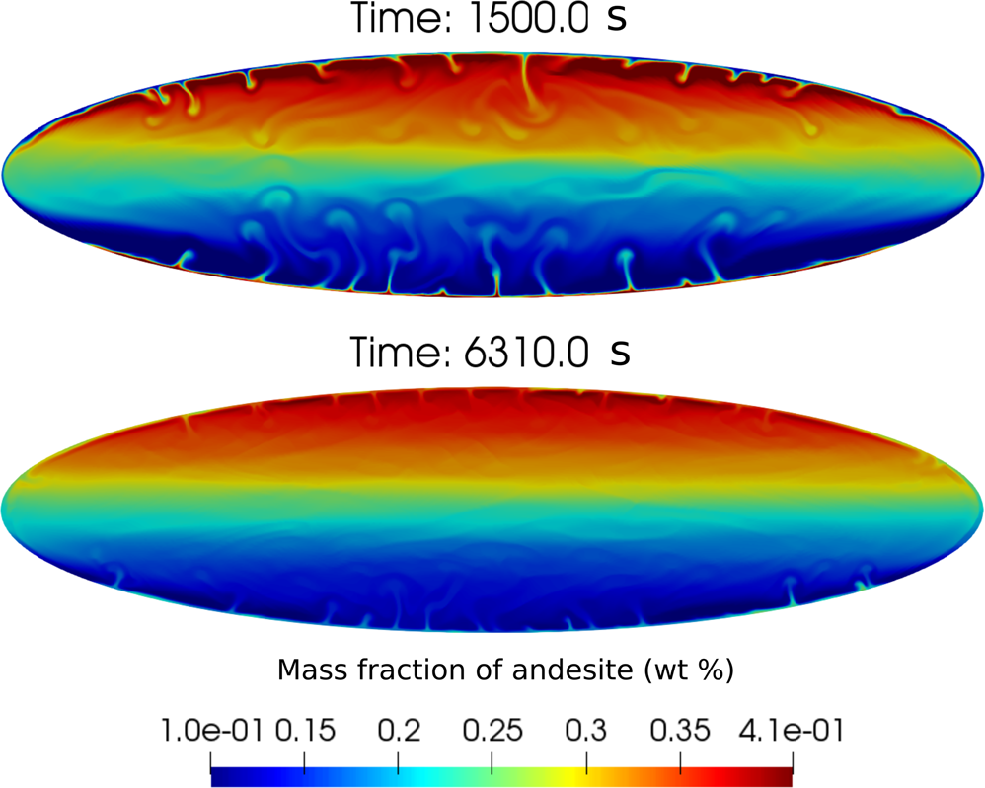
Viscous flow
In a magma chamber
Garg et al., 2019
Notes:
Temporal evolution of plume generation during third phase by andesite at the bottom boundary layer and dacite at the top boundary layer for simulation #1. The boundary layers become thinner with time.

Slide 13
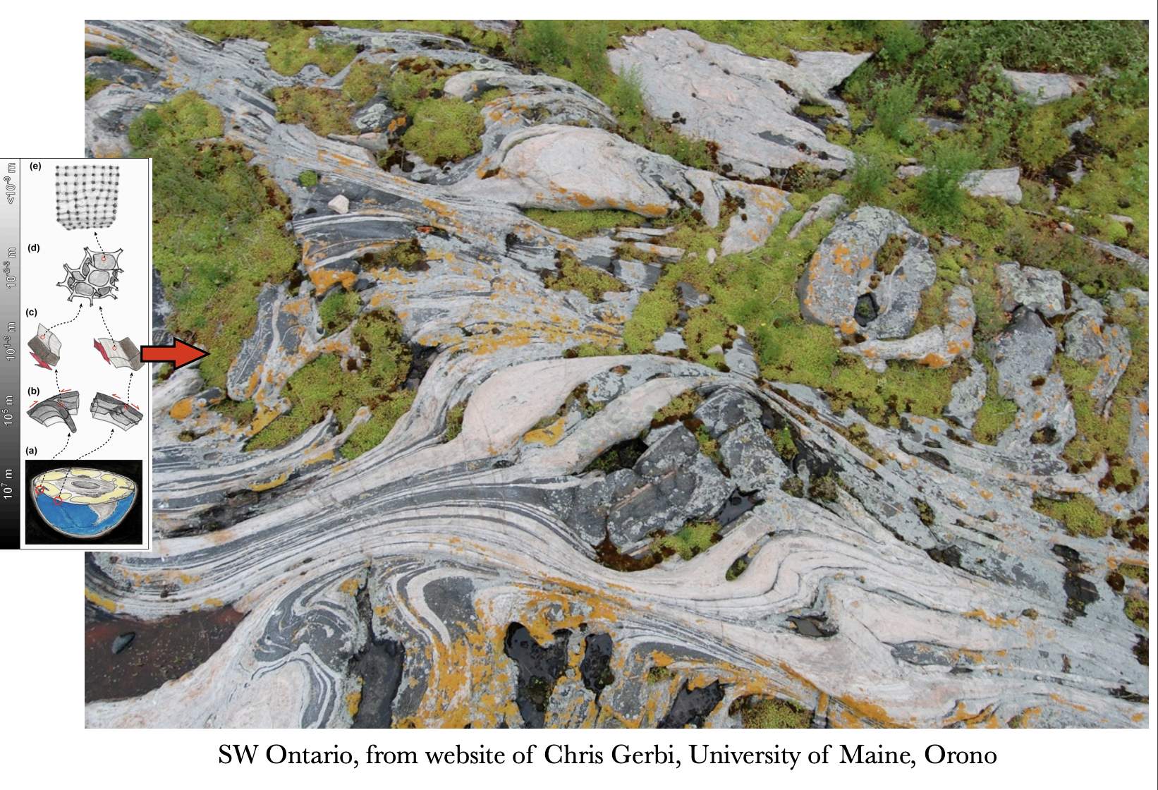
Viscous flow
In a magma chamber
In the lower crust
Garg et al., 2019
Notes:
Temporal evolution of plume generation during third phase by andesite at the bottom boundary layer and dacite at the top boundary layer for simulation #1. The boundary layers become thinner with time.

Slide 14
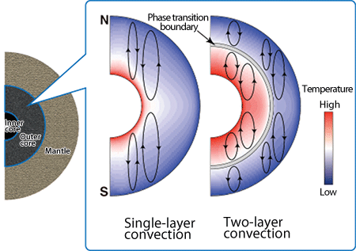
Viscous flow
In a magma chamber
In the lower crust
Garg et al., 2019
Ozawa et al., 2011
In the outer core
Notes:
Temporal evolution of plume generation during third phase by andesite at the bottom boundary layer and dacite at the top boundary layer for simulation #1. The boundary layers become thinner with time.

Slide 15
Viscous flow
Elasticity: $σ∝ ε$
Brittle failure/plastic yielding at $σ≥ σ_{y}$
In the case of viscous flow, how are force (stress) and deformation (displacement/strain/strain rate) related?
Notes:
https://www3.nd.edu/~cneal/PlanetEarth/Chapt-11a-Rock-Mechanics.pdf

Slide 16
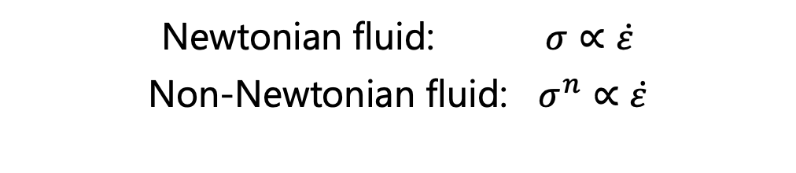
Viscous flow
Elasticity: $σ∝ ε$
Brittle failure/plastic yielding at $σ≥ σ_{y}$
In the case of viscous flow, how are force (stress) and deformation (displacement/strain/strain rate) related?
Newtonian fluid: $σ∝\dot{ε}$
Non-Newtonian fluid: $σ^{n}∝\dot{ε}$
Notes:
https://www3.nd.edu/~cneal/PlanetEarth/Chapt-11a-Rock-Mechanics.pdf

Slide 17
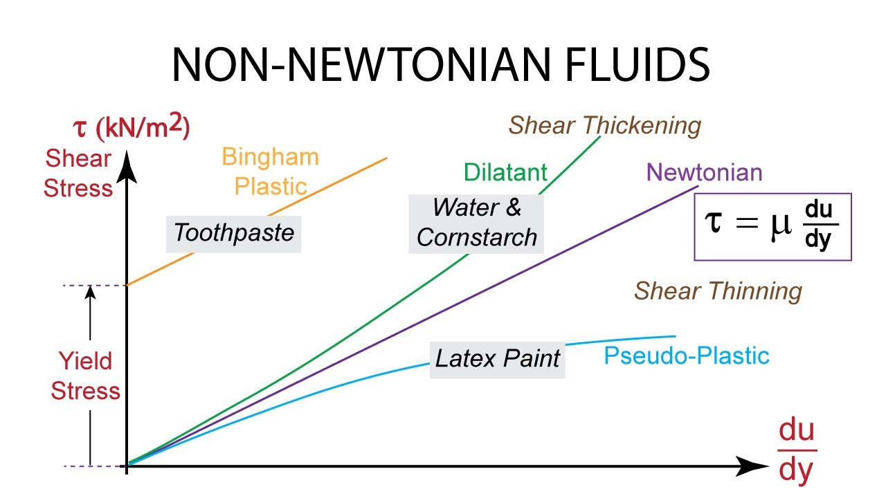
Examples of non-Newtonian fluids

Slide 18
Examples of non-Newtonian fluids
Latex paint has n > 1 behavior
(i.e., reduction in viscosity/slope as strain rate increases)

Slide 19
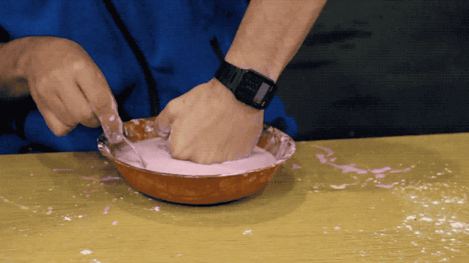
Examples of non-Newtonian fluids
Water and corn starch (+ food coloring)

Slide 20

To the stylus…
To: understand Newtonian vs. non-Newtonian fluids, “effective” viscosity concept, plasticity

Slide 21
What about fluids?
Viscous flow
Becker and Faccenna

Slide 22
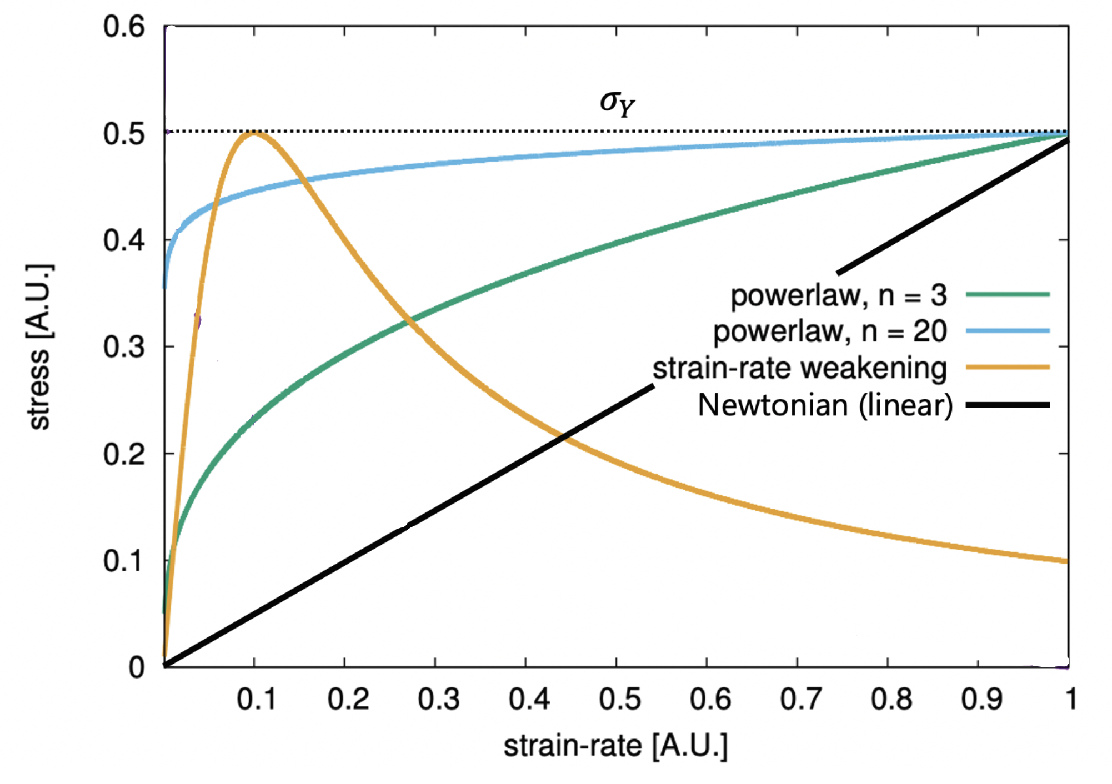
Power-law flow mimics plasticity as n $→∞$
Becker and Faccenna

Slide 23
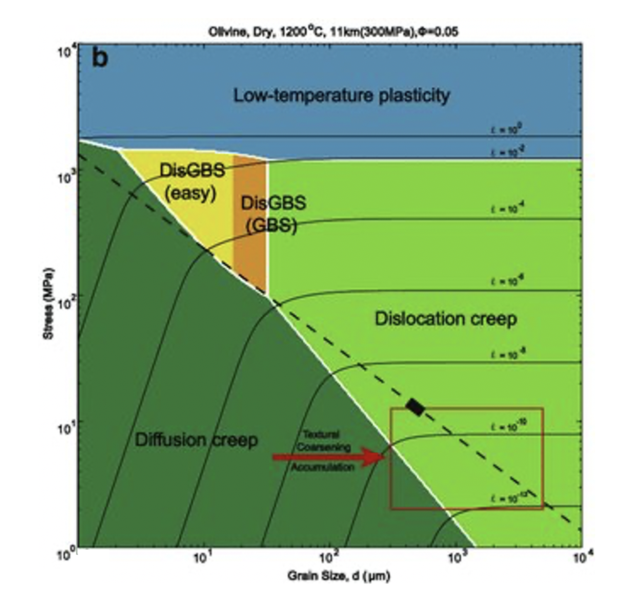
Next class: Viscous flow in the mantle
Zhuosen et al., 2017
Notes:
https://www.researchgate.net/publication/316874615_Kinetic_processes_for_plastic_deformation_of_olivine_in_the_Poyi_ultramafic_intrusion_NW_China_Insights_from_the_textural_analysis_of_a_1700_m_fully_cored_succession/figures?lo=1

Slide 24
Next class: Viscous flow in the mantle
Zhuosen et al., 2017
$$σ= σ_{y}$$
$$σ^{n}∝\dot{ε}$$
$$σ∝\dot{ε}$$
Notes:
https://www.researchgate.net/publication/316874615_Kinetic_processes_for_plastic_deformation_of_olivine_in_the_Poyi_ultramafic_intrusion_NW_China_Insights_from_the_textural_analysis_of_a_1700_m_fully_cored_succession/figures?lo=1

Slide 25
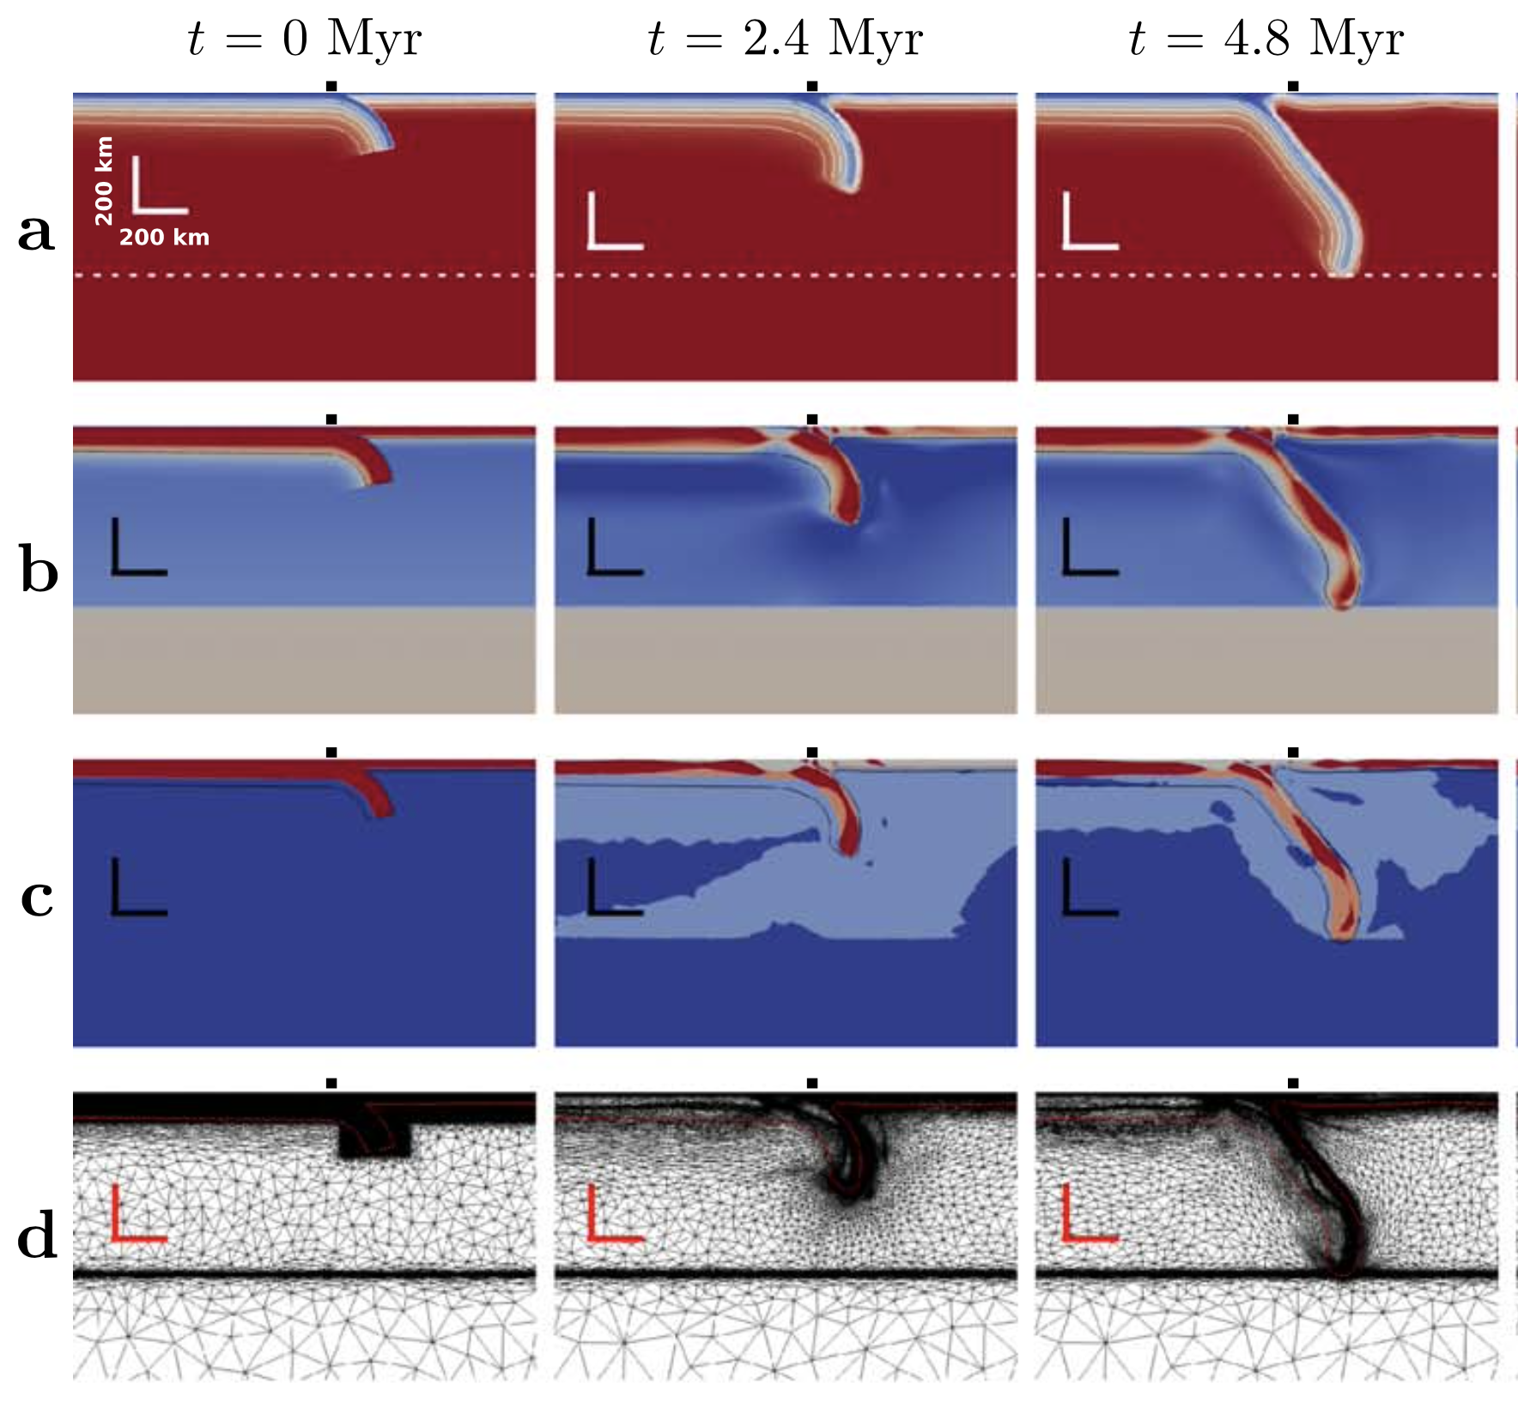
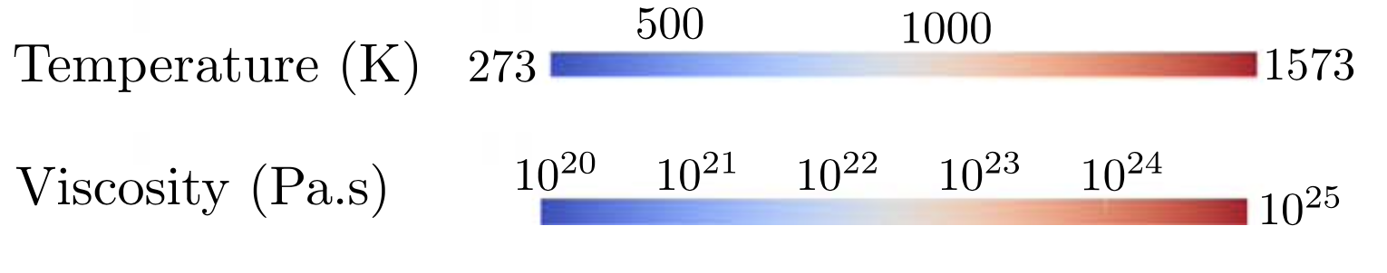
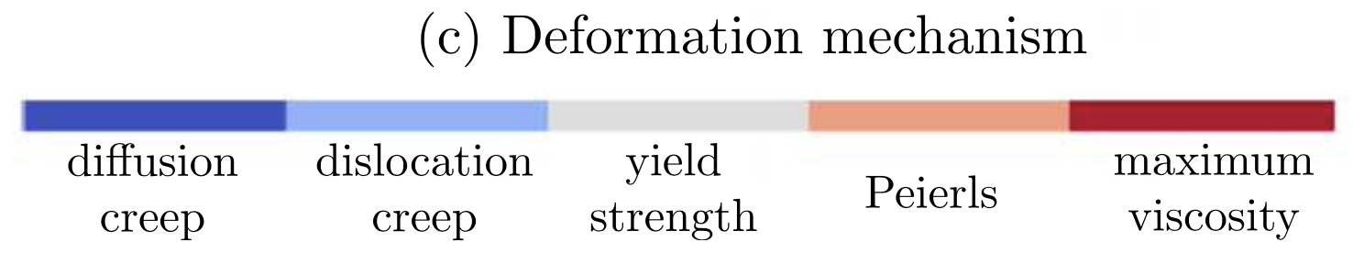
Next class: Viscous flow in the mantle

Slide 26
Next class: Viscous flow in the mantle
Garel et al., 2014, G³

Slide 27
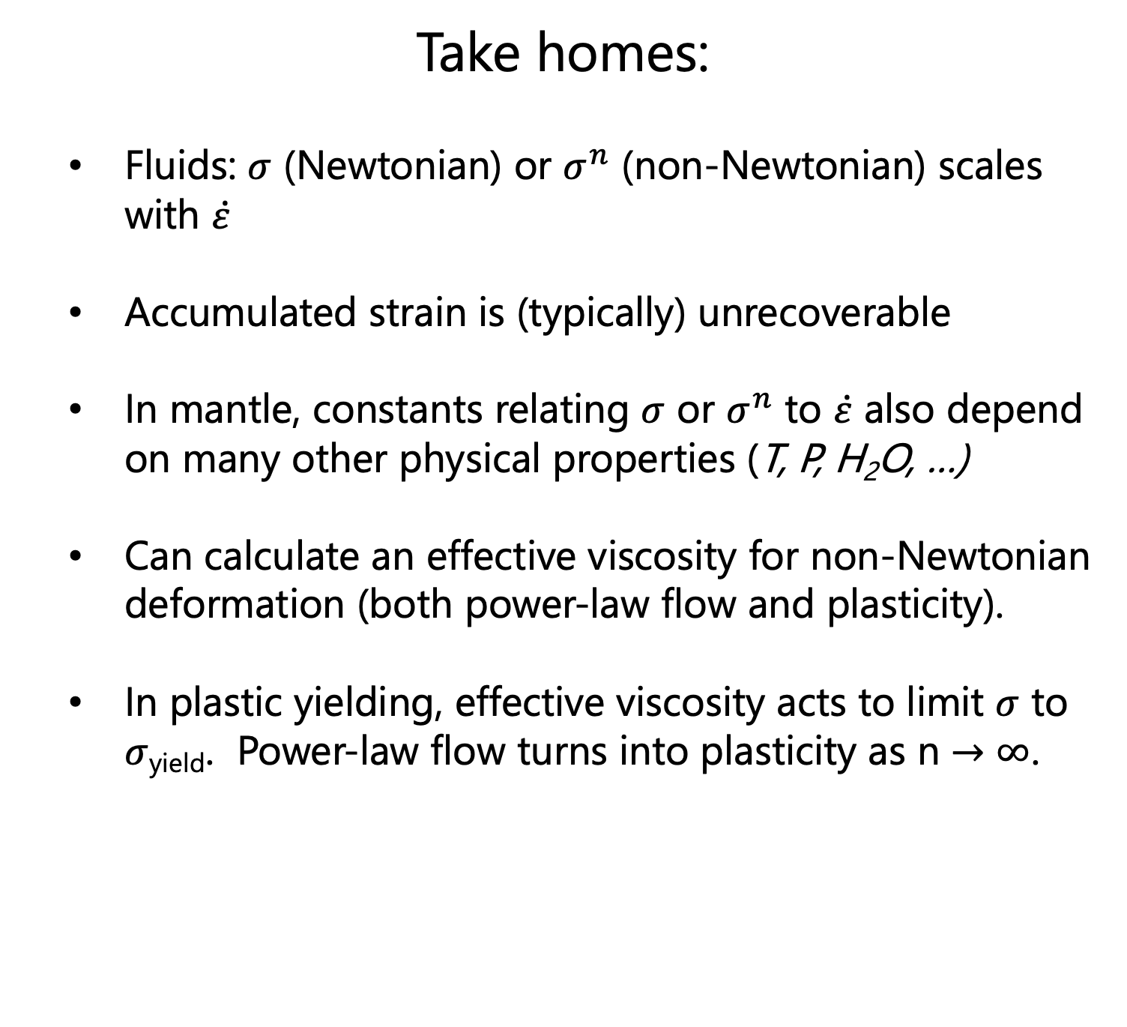
Take homes:
Fluids: $σ$ (Newtonian) or $σ^{n}$ (non-Newtonian) scales with $\dot{ε}$
Accumulated strain is (typically) unrecoverable
In mantle, constants relating $σ$ or $σ^{n}$ to $\dot{ε}$ also depend on many other physical properties (T, P, H₂O, …)
Can calculate an effective viscosity for non-Newtonian deformation (both power-law flow and plasticity).
In plastic yielding, effective viscosity acts to limit $σ$ to $σ$_{yield}. Power-law flow turns into plasticity as n $→∞$.

